Slide 1
Power BI Azure Synapse Analytics
Rahul Vats
April 22 2022

Slide 2
Objectives
Introduction to Power BI and how to use it in conjunction with other Azure Products such as Azure Synapse Analytics
Identify ways you can solve real-world problems for clients with Azure cloud technologies​ and Power BI
Apply your learnings to a hands-on build based on a common business challenge​

Slide 3

Modules
Power BI with Azure Synapse Overview
Demo

Slide 4
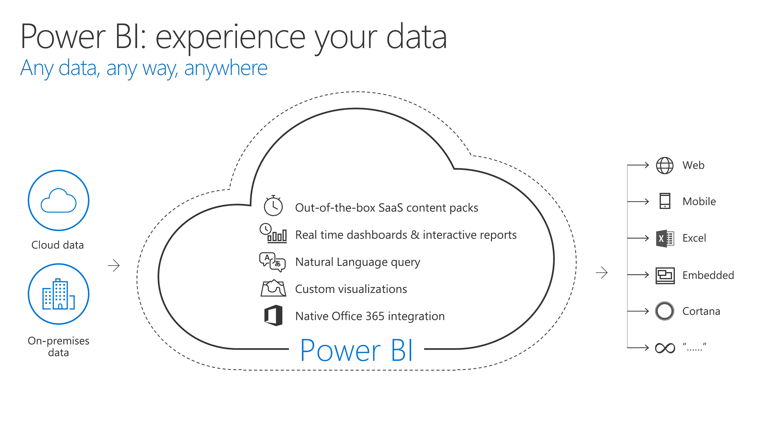

Slide 5
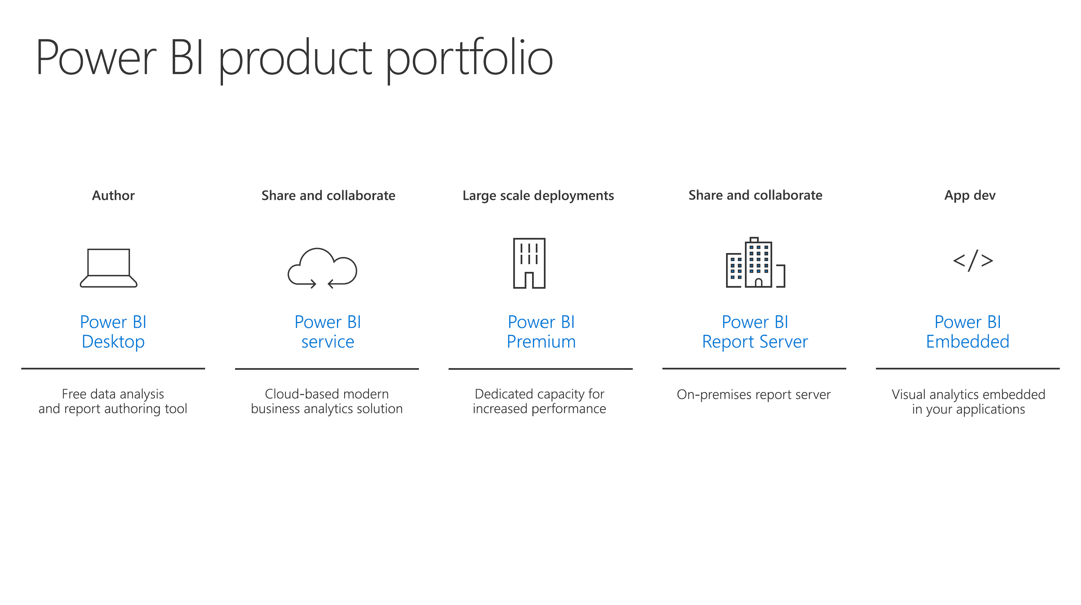

Slide 6
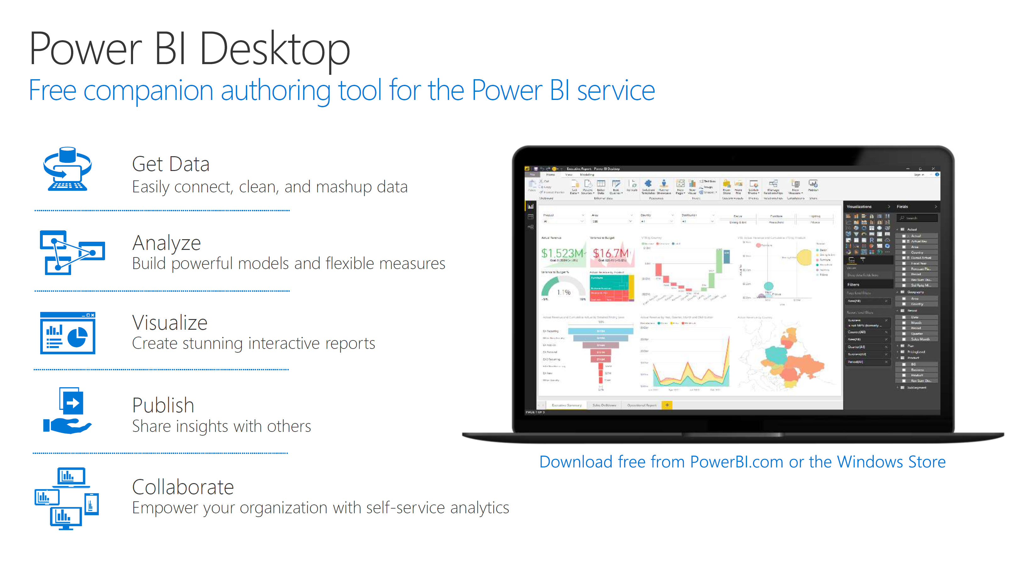

Slide 7
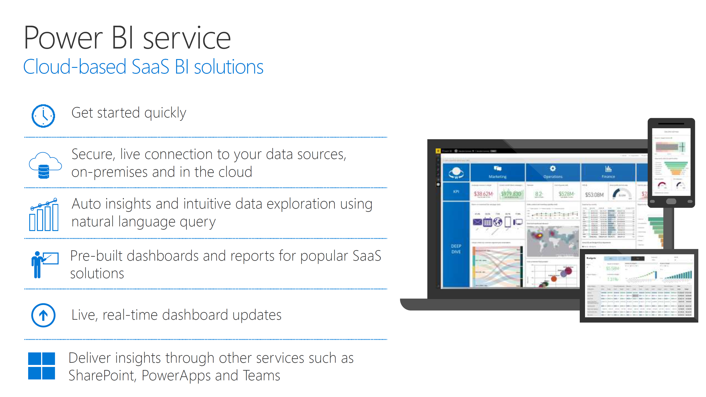

Slide 8
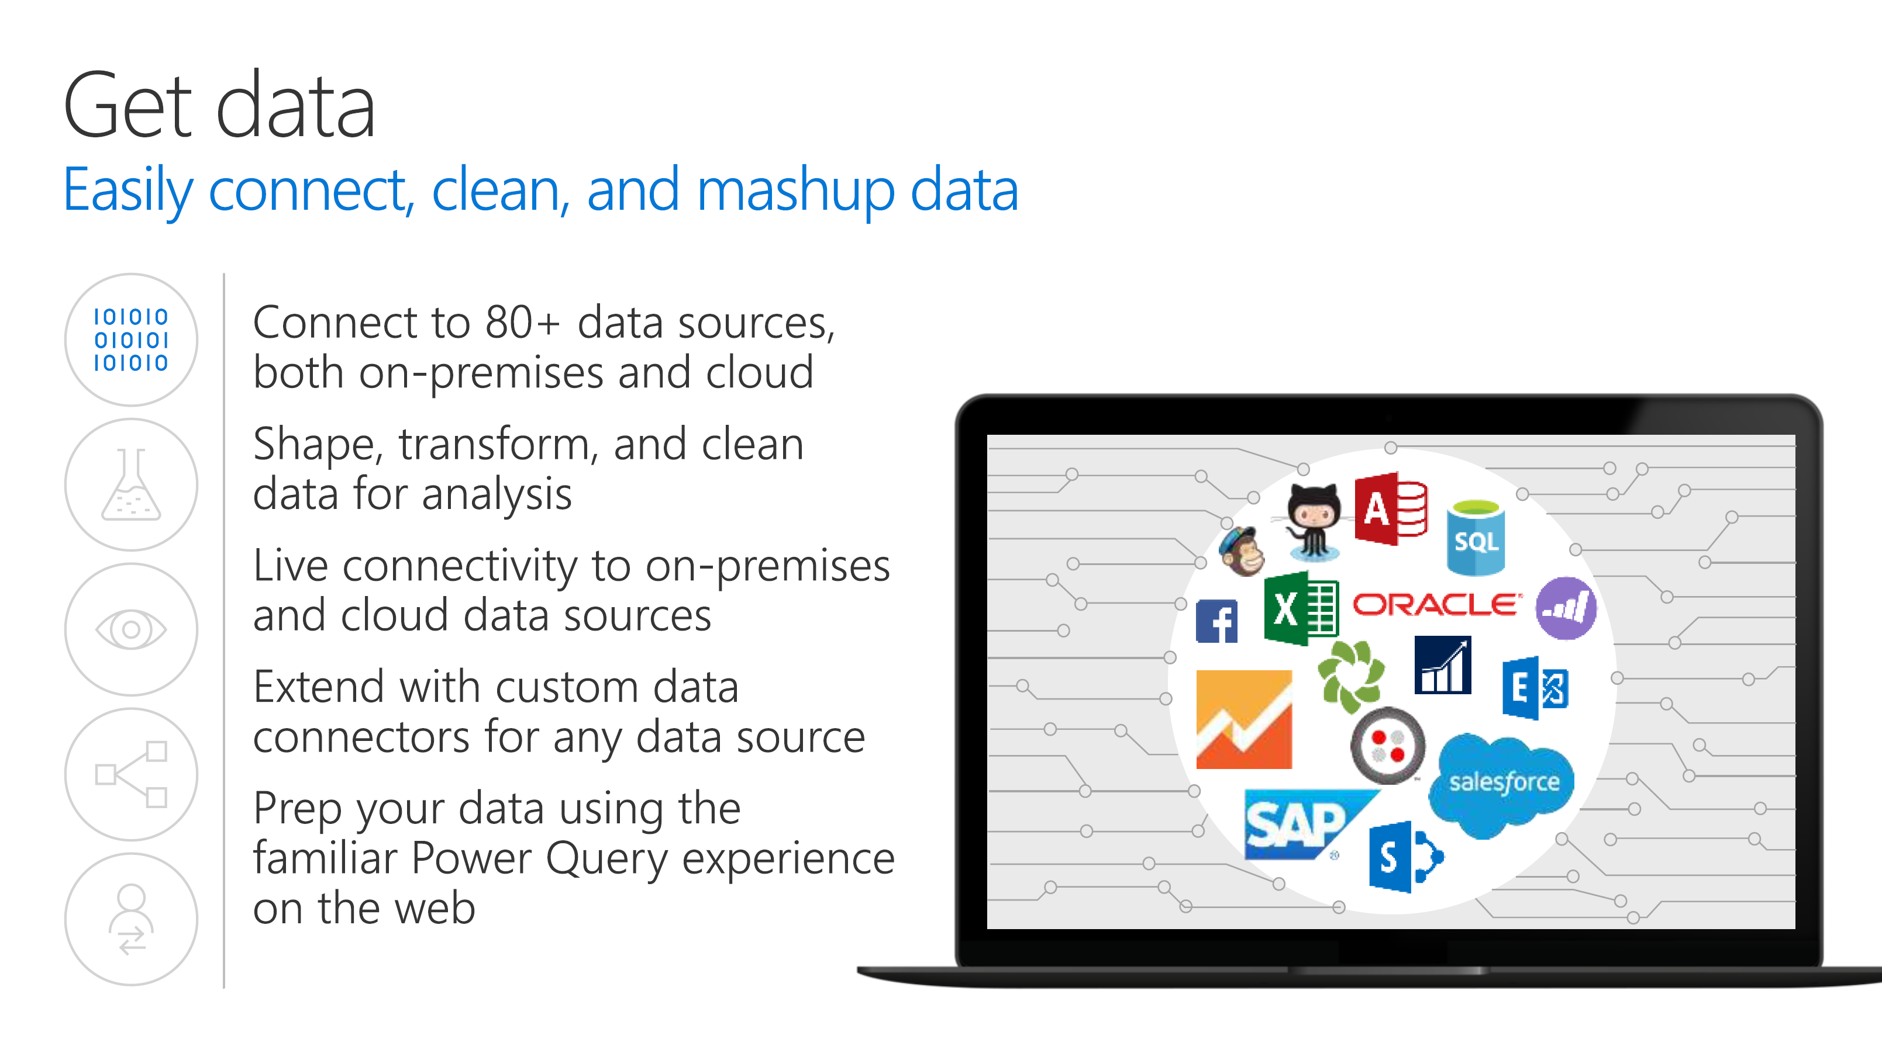

Slide 9
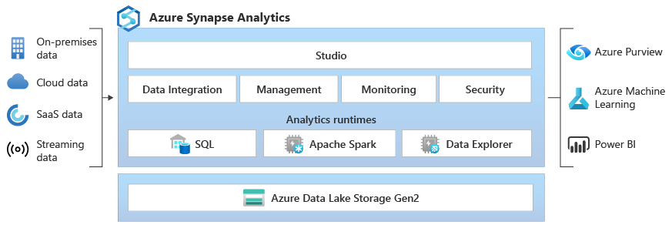
What is Azure Synapse
Notes:
Azure Synapse is an enterprise analytics service that accelerates time to insight across data warehouses and big data systems. Azure Synapse brings together the best of SQL technologies used in enterprise data warehousing, Spark technologies used for big data, Data Explorer for log and time series analytics, Pipelines for data integration and ETL/ELT, and deep integration with other Azure services such as Power BI, CosmosDB, and AzureML.

Slide 10
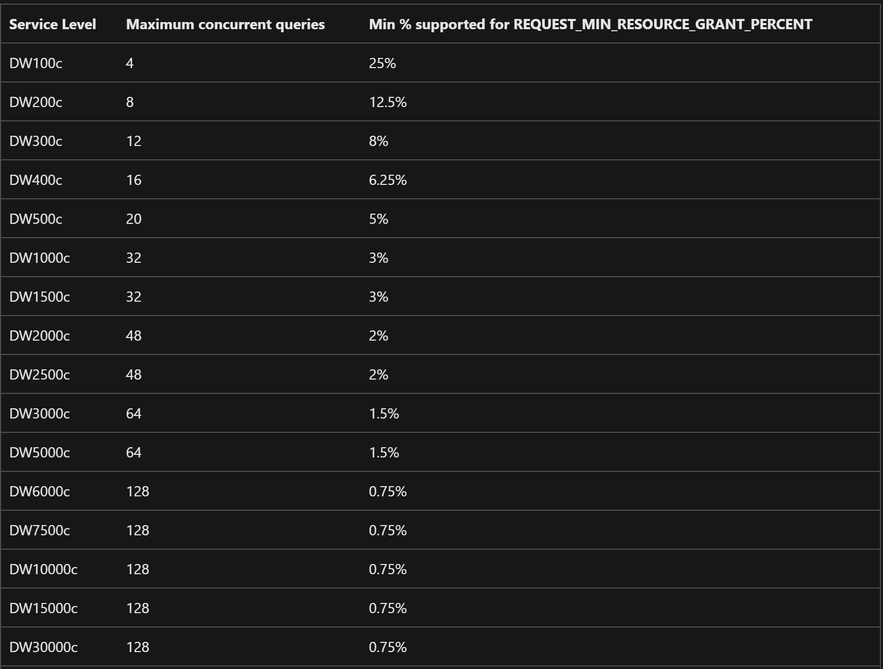
With the introduction of workload groups, the concept of concurrency slots no longer applies. Resources per request are allocated on a percentage basis and specified in the workload group definition. However, even with the removal of concurrency slots, there are minimum amounts of resources needed per queries based on the service level. The below table defined the minimum amount of resources needed per query across service levels and the associated concurrency that can be achieved.

